Slide 1

Microsoft power bi
PT. INOVASI MEMBANGUN BANGSA
BY : SAFRIL SIDIK

Slide 2
WHAT IS POWER BI..?
Microsoft Power BI merupakan sebuah aplikasi bisnis intelligence milik Microsoft yang memungkinkan Anda untuk mengolah data lebih detail dan menampilkannya dalam grafis yang lebih interaktif dan mudah dipahami oleh user. Selain itu Anda dapat mengontrol data yang sudah ada dan melakukan konfigurasi otomatis sebagai penanganan jika ada manipulasi data. Platform ini mendukung berrbagai sumber data seperti data dari sumber csv, excel ataupun berbagai macam database dan layanan cloud. Aplikasi ini juga dapat berjalan di beberapa platform seperti PC/laptop, Android atau IOS.

Slide 3
WhY WE ARE USING power bi…??
Connect to and visualize any data using the unified, scalable platform for self-service and enterprise business intelligence (BI) that’s easy to use and helps you gain deeper data insight.
Easily connect to, model, and visualize your data, creating memorable reports personalized with your KPIs and brand. Get fast, AI-powered answers to your business question, even when asking with conversational language.
Make the most of your big data investments by connecting to all your data sources with the scale to analyze, share, and promote insights across your organization while maintaining data accuracy, consistency, and security.
Work together easily on the same data, collaborate on reports, and empowering everyone in your organization to quickly make data-driven decisions that drive strategic actions.

Slide 4
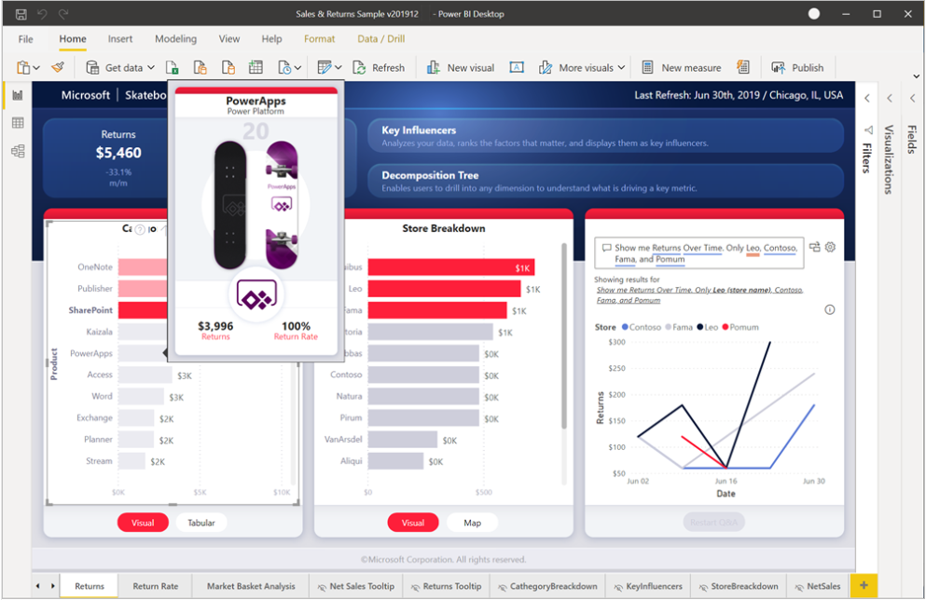
CLICK TO CHECK ANOTHER POWER BI REPORT SAMPLES

Slide 5
INTALLATION POWER BI DESKTOP
Click here to download application
GETTING STARTED WITH THE DOCUMENTATION
VIDEO TUTORIAL
SYSTEM REQUIREMENTS
Minimum ram 2GB
Windows 10, Windows Server 2012 R2, Windows Server 2012, Windows 8, Windows 8.1, Windows Server 2016, Windows Server 2019
Microsoft Power BI Desktop requires Internet Explorer 10 or greater.

Slide 6
WHY WE ARE USING POWER BI DESKTOP..?
Get data
Create relationships and enrich your data model with new measures and data format
Create reports
Save your reports
Upload or Publish your reports

Slide 7
THANKYOU SEE YOU NEXT LESSON
PT. INOVASI MEMBANGUN BANGSA

